Slide 1
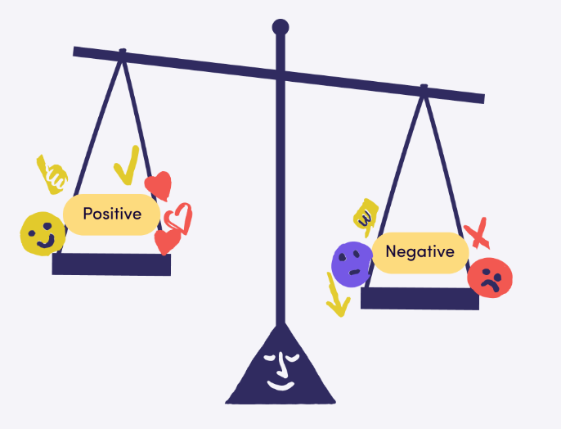

Tree Segmentation in Aerial Forest Images
Trying To Be Better
Xicheng Peng(z5526784)
Yichen Zhu(z5610836)
Shuo Yang(z5389396)
Weizhao Yuan(z5530932)
Xiangming Hou(z5564067)

Slide 2
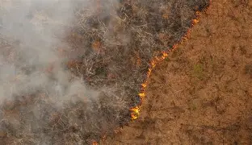
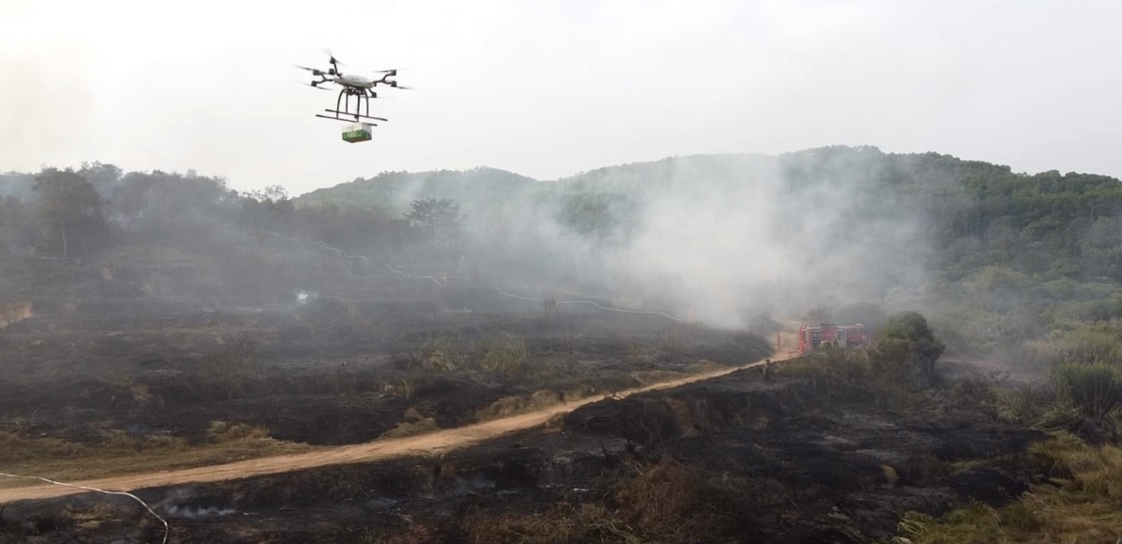
Introduction
Project Background
The Importance of Forest Health Monitoring User Feedback
The influence of deadwood on the spread of wildfires
Traditional manual inspection vs. Computer vision automation
Task Description
Objective: Segmentation of dead trees in aerial images
Deal with issues such as shadow interference,
similar textures, and small target detection.
Presenter:

Slide 3
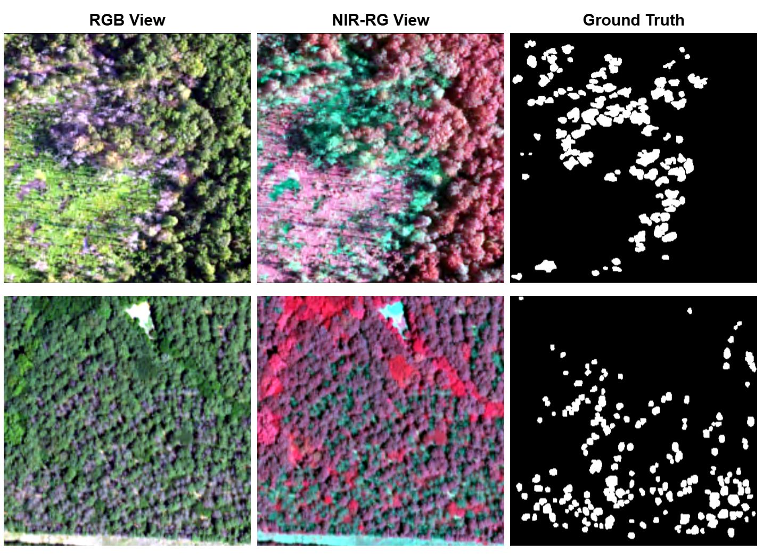
Dataset Introduction
Kaggle:
444 aerial images
RGB + NIR (Near Infrared) four-band data
Data Characteristics
The target area accounts for only 1.9% on average.
Dead trees have similar textures to the background (soil, rocks).
The classification is difficult due to tree shadows.
Presenter:

Slide 4
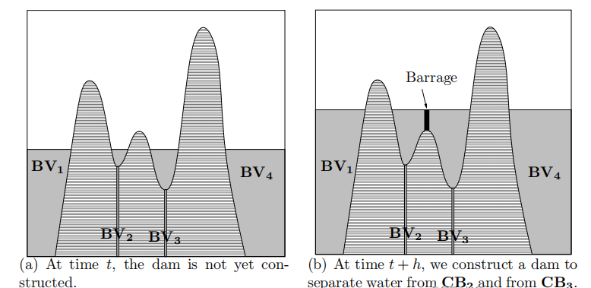
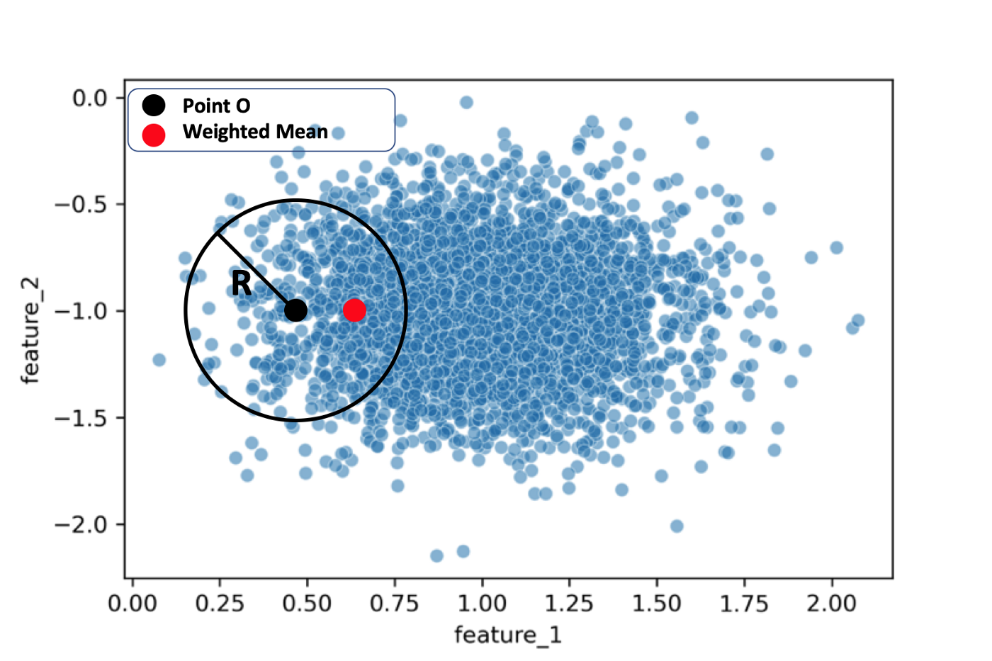
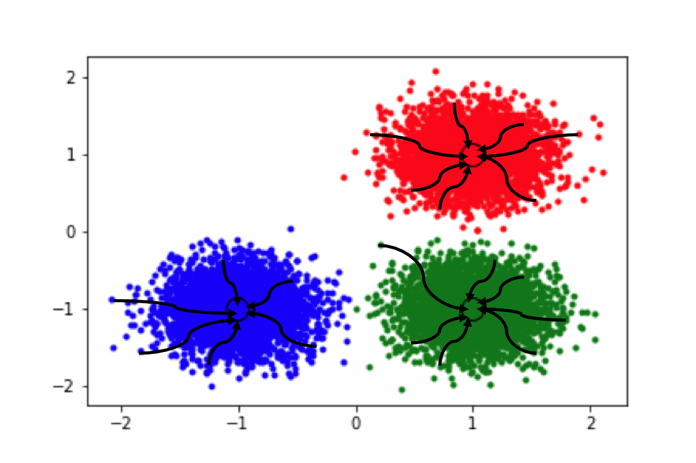
Method Introduction
Traditional methods:
Watershed Segmentation :
Principle: Gradient-based edge detection
Advantage: Sensitive to boundaries
Disadvantage: Prone to over-segmentation, mIoU is only 0.015
MeanShift Clustering:
Principle: Clustering based on kernel density estimation
Advantage: Adaptive clustering quantity
Disadvantage: High computational cost, mIoU is only 0.0286
Watershed algorithm
Mean shift
Presenter: Yichen Zhu

Slide 5
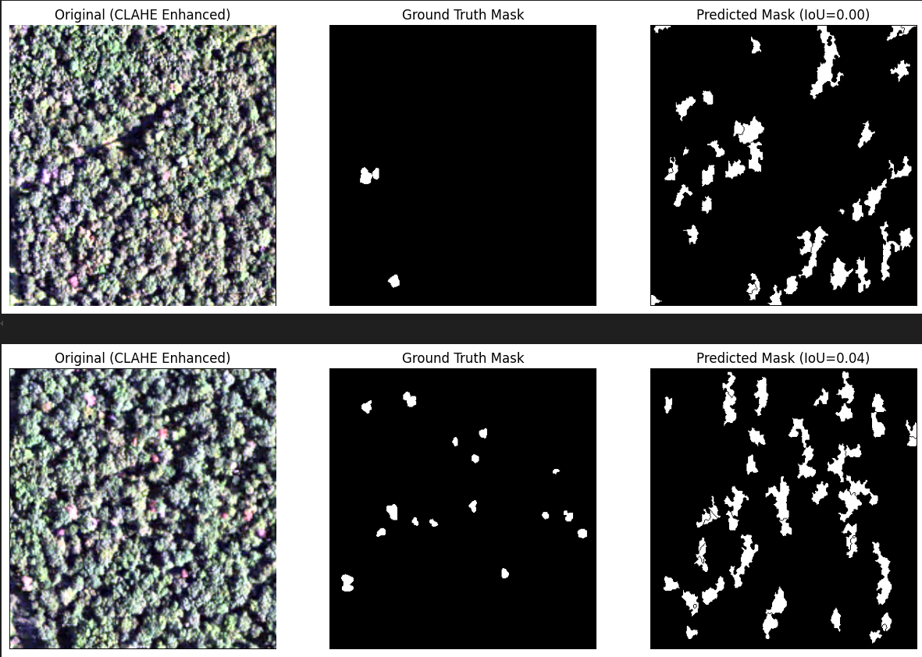
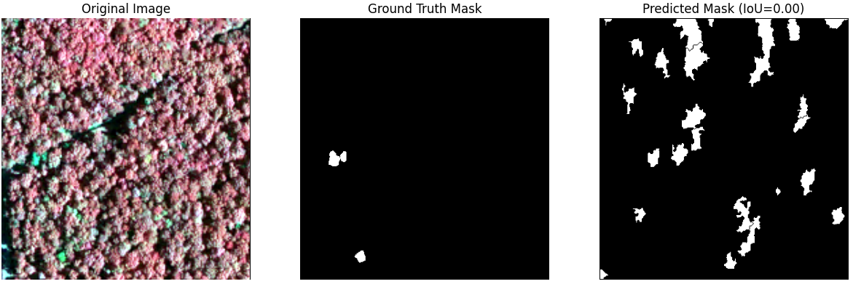
Model introduction
Watershed Segmentation
Result:
Watershed mean IoU(RGB): 0.0155,time: 12.39s
Watershed mean IoU(NRG): 0.0097, time: 4.52s
The algorithm tends to over-segment in complex natural scenes like forests due to high texture and noise, producing many false positives.
Watershed(RGB)
Watershed(NRG)
Presenter: Yichen Zhu

Slide 6
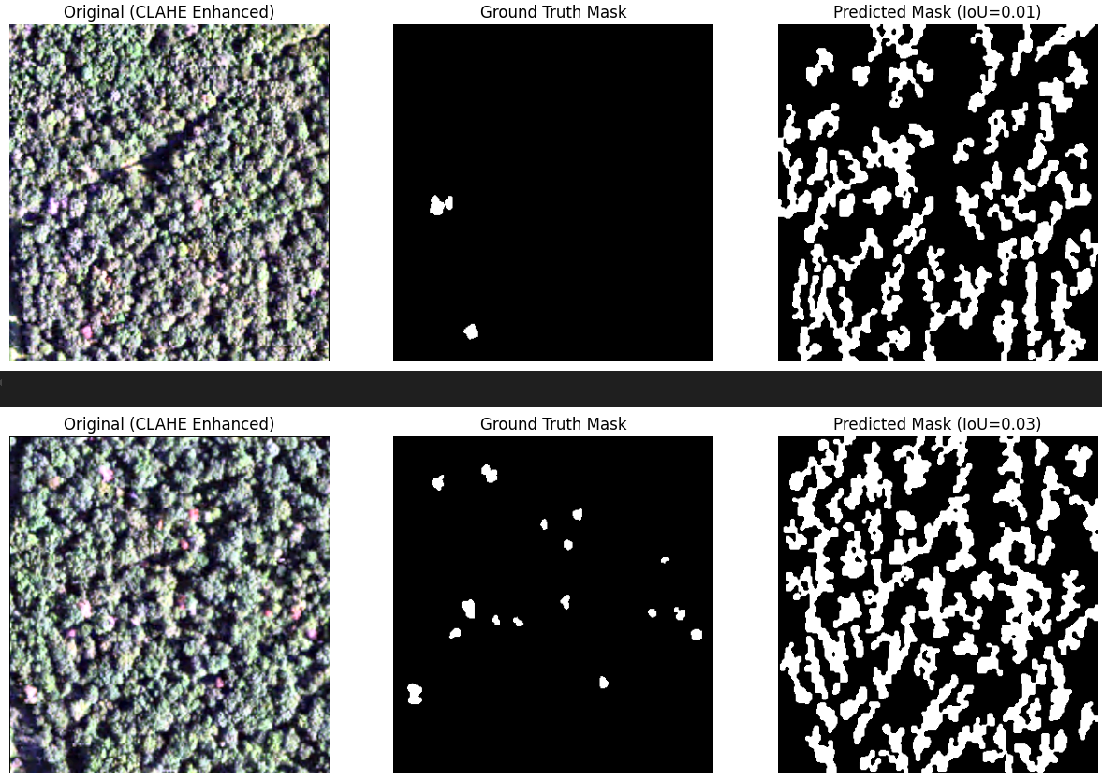
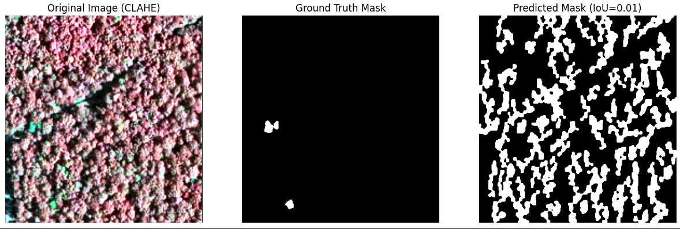
Model introduction
MeanShift Clustering
Result:
MeanShift mean IoU(RGB): 0.0286,time: 1360.40s
MeanShift mean IoU(NRG): 0.0218, time: 1313.57s
Same as Watershed, the method tends to over-segment textured regions like forests, leading to many false positives.
MeanShift(RGB)
MeanShift(NRG)
Presenter: Yichen Zhu

Slide 7
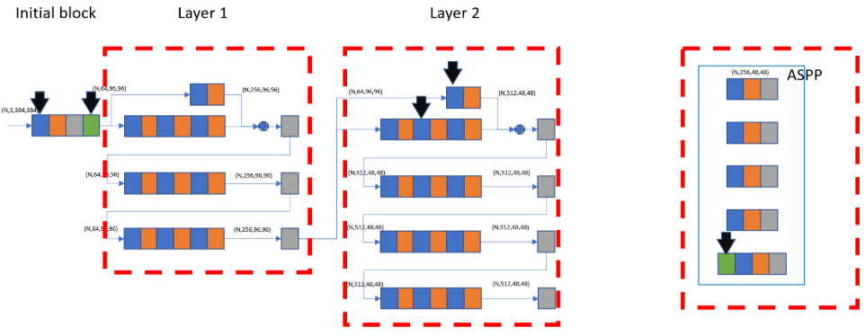
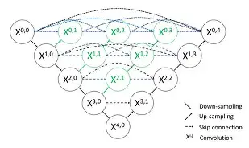
Method Introduction
Deep learning methods:
DeepLabv3+ResNet-50
Empty convolution + ASPP module
Single-modal NRG: mIoU 0.2279
RGB + NRG multimodal fusion: mIoU 0.2542 (improvement of 11.5%)
U-Net/U-Net++
Encoder-Decoder architecture + Jumping Connections
U-Net (RGB): mIoU 0.3719
U-Net++ (Medium Enhancement): mIoU 0.4320 (Best)
classifier
U-Net
Presenter:

Slide 8
Model introduction
Details here …
Presenter:

Slide 9
Experimental Setup
Data division:
80% for training(355 pieces), 20% for testing(89 pieces)
Comparison of Data Augmentation Strategies:
Traditional method:
No data augmentation strategy
• Data processing:
Watershed: BGR → LAB → CLAHE → BGR → Grayscale
Mean Shift: BGR → LAB → CLAHE → BGR → Downsampling → Grayscale
Deep learning methods:
Four enhancement strategies: None, Light, Medium, Strong
• DeepLabv3+ResNet-50: It mentions training augmentation (rotation + color jittering)
• U-Net/U-Net++: Detailed tests were conducted on 4 enhancement strategies and the results were presented
Presenter:

Slide 10
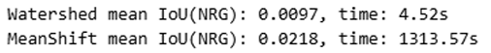
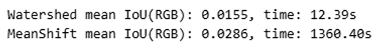
Result comparison
Evaluation indicators
Main metric: mIoU (mean intersection-over-union)
Auxiliary metrics: Precision, Recall
Calculation formula: IoU = (Intersection of Prediction ∩ Truth) / (Union of Prediction ∪ Truth)
Watershed & MeanShift model(NRG)
Watershed & MeanShift model(RGB)
Presenter:

Slide 11
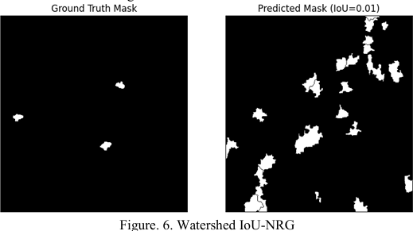
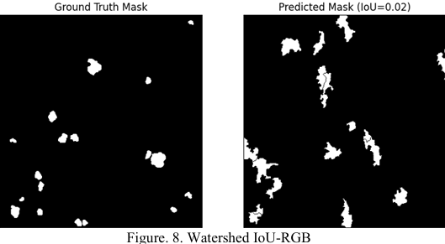
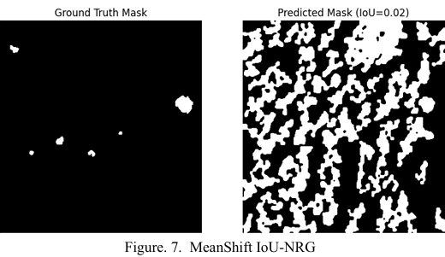
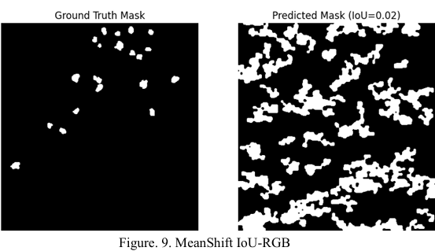
Result comparison
Watershed IoU-NRG
MeanShift IoU-NRG
Watershed IoU-RGB
MeanShift IoU-RGB
Presenter:

Slide 12
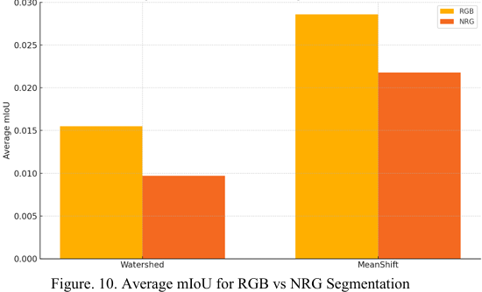
Result comparison
Average mIoU for RGB vs NRG Segmentation
Presenter:

Slide 13
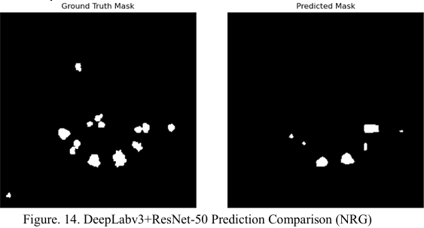
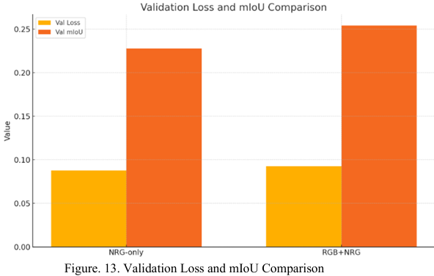
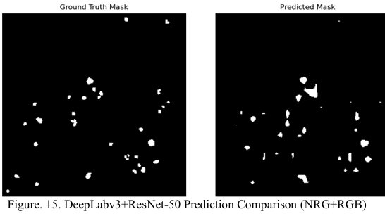
Result comparison
Deeplabv3 -NRG model (NRG)
Deeplabv3 -NRG+RGB model
Validation Loss and mIoU Comparison
DeepLabv3+ResNet-50 Prediction Comparison (NRG)
DeepLabv3+ResNet-50 Prediction Comparison (NRG+RGB)
Presenter:

Slide 14
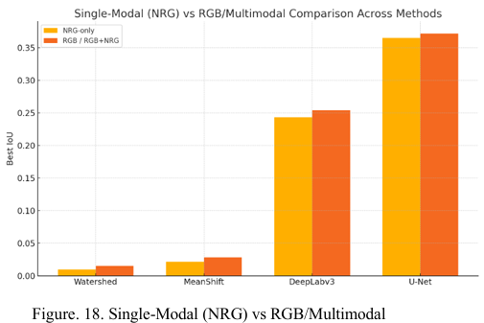
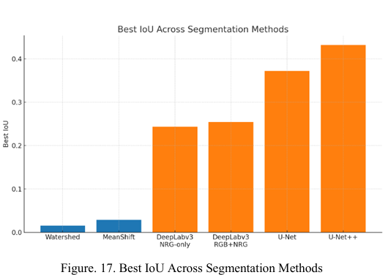
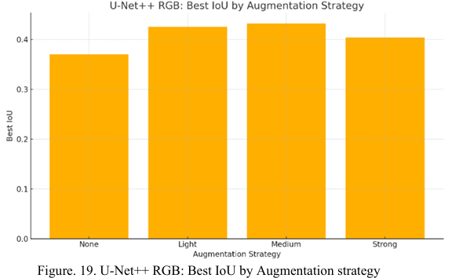
Result comparison
Single-Modal (NRG) vs RGB/Multimodal
U-Net++ RGB: Best IoU by Augmentation strategy
IoU Across Segmentation Methods
Presenter:

Slide 15
Discussion
Key Findings
Performance break:
• through comparison Traditional → Deep Learning: 20-fold performance improvement
Watershed: 0.0155 → U-Net++: 0.4320
The fundamental limitations of traditional methods:
Watershed issue:
Over-reliance on gradient information
Extremely sensitive to noise and texture variations
Example: Mistakenly identifying the tree shadow as a dead tree.
MeanShift Problem:
Based solely on color space clustering
Ignoring spatial structure information
Unable to handle complex backgrounds
Example: Unable to distinguish brown soil from dead wood
Presenter:

Slide 16
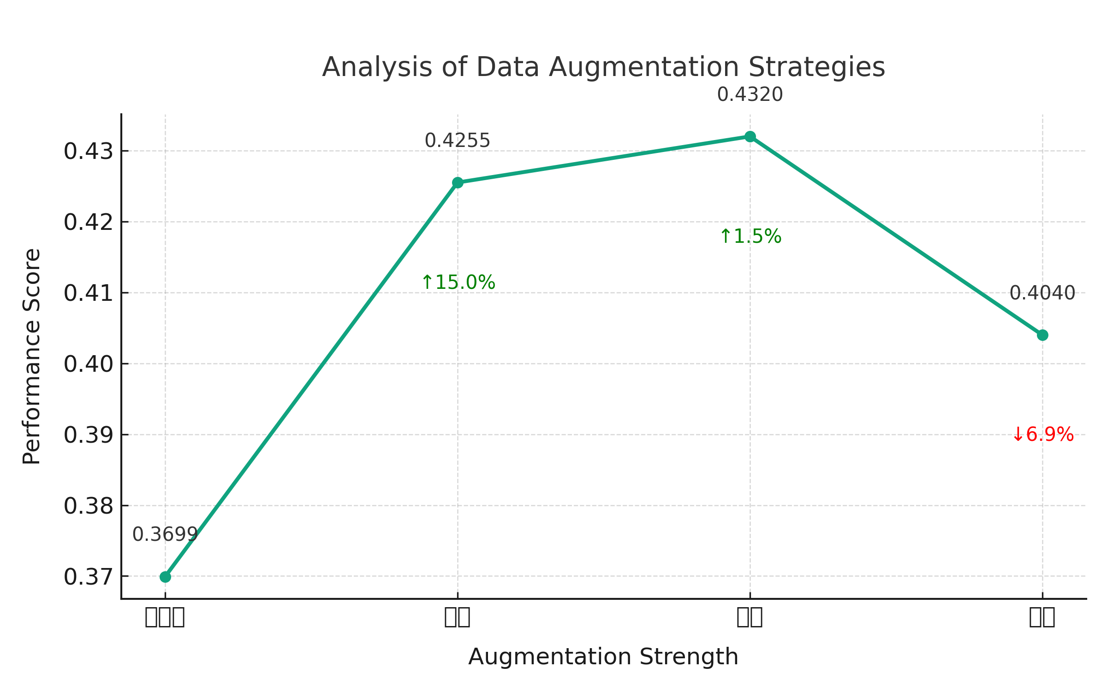
Discussion
The advantages of deep learning mechanism
Hierarchical Feature Learning:
Lower level: Edge, texture
Middle level: Local patterns, tree crown shape
Upper level: Semantic concepts (healthy tree vs dead tree)
Analysis of Data Augmentation Strategies
Moderate Enhancement (Optimal Configuration):
Geometric transformation: Horizontal/Vertical Flip + ±15° Rotation
Color adjustment: Brightness ±20%, Contrast ±20%
Balance: Information Retention vs. DiversityKey: Simulation of Real Aerial Photography Angles and Light Changes
Presenter:

Slide 17
Future Work
Dataset issue
Only 444 images (deep learning usually requires thousands)
Single geographical area (generalization ability unknown)
Enhance strategy optimization
Introduce Cutout, HSV jitter, GridMask enhancement, etc.
Automated enhanced strategy search
Data-Level Improvements
Different forest types: coniferous forest, broad-leaved forest, mixed forest)
Different terrains: plain, mountainous area, hilly area
Objective: to improve generalization performance
Special optimization for shadow issues
Shadow detection preprocessing
Train an independent shadow detector
- Enhance the shadow area using NIR weights
Presenter:

Slide 18

Presenter:

